Slide 1
Wellness Announcements
Stephanie, Susie, Summar

Slide 2
Maintaining Mental & Emotional Health
1. Stay up to date on what is happening, while limiting your media exposure.
2. Look to credible sources for information (CDC, WHO, local government webpages)
3. Take care of your body through breathing exercises, getting 7-9 hours of sleep, eating well, exercising, and avoiding alcohol and drugs.
4. Make time to unwind by doing other activities.
5. Connect with others through video calls and texting. Talk with people you trust about your concerns and how you are feeling.
6. Maintain a sense of hope an positive thinking (gratitude journaling)
Notes:
- there's a lot of misinformation; make sure to refer to credible sources like the CDC and WHO for up-to-date information

Slide 3
5 Tips for Working from Home
1. Get dressed:
Changing out of clothing you associate with sleep and rest helps to psychologically prepare to start work.
2. Establish boundaries:
Start and finish your day at the same time you would normally arrive at and leave the office.
At end of day, switch off computer & tidy away papers and other items.
3. Take a short walk or run around the block.
4. Pick up the phone for real conversation to not rely on solely email and instant messaging.
5. Take regular breaks: get up from your desk and move around just as you would in office.
Notes:
"Many people tend to over communicate when working from home - either wanting to 'be seen', or overcompensating to ensure people know what they are up to. That's fine - but don't go over the top. You know if you're on task and being productive - keep yourself in check."
Research has also found that short breaks throughout the day are more beneficial than less frequent, longer breaks.
Many home workers recommend the Pomodoro Technique, a method of time management which breaks your working day into 25 minute chunks. Each chunk is followed by a five minute break.
Source: https://www.bbc.com/news/business-51868894

Slide 4
POA Virtual Activity Ideas
Tea Time/Coffee Breaks
Lunch Gatherings
Yoga Sessions
Meditation Sessions
Brown Bag Discussions
Virtual Happy Hours/Game Nights
Virtual Walks/Walking Meetings
Notes:
Virtual workouts: https://www.washingtonian.com/2020/03/16/these-fitness-studios-will-stream-workout-classes-while-everyone-is-staying-at-home/
Virtual museum tours: https://artsandculture.google.com/project/streetviews
Virtual zoo/aquarium livestreams: https://www.facebook.com/montereybayaquarium/videos/219520122494107/
Virtual book club
Learn a language: Duolingo/sign language app
Audit a free online class: https://www.classcentral.com/course/ucimacroeconomics-1050

Slide 5
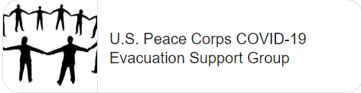

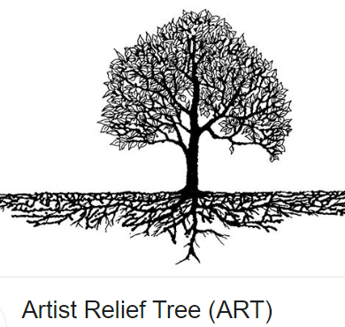

Helping Others
Donate
Participate in calling programs
Support artists, Peace Corps evacuees, and others

Slide 6

An uplifting message
And the people stayed home. And read books, and listened, and rested, and exercised, and made art, and played games, and learned new ways of being, and were still. And listened more deeply. Some meditated, some prayed, some danced. Some met their shadows. And the people began to think differently.
And the people healed. And, in the absence of people living in ignorant, dangerous, mindless, and heartless ways, the earth began to heal.
And when the danger passed, and the people joined together again, they grieved their losses, and made new choices, and dreamed new images, and created new ways to live and heal the earth fully, as they had been healed.
~ Kitty O'Meara

